Slide 1
Process Control
Course II
Lecture 9
The Stability
Part II
By
Prof. Alaa Kareem Mohammed

Slide 2
Routh test
Characteristic equation of a closed-loop system is
$$1+G_{c}G_{v}G_{p}G_{m}=0$$
$XL$(s)
$$G_{L}$$
$$1+GG_{m}=0$$
+
$Ysp$(s)
+
+
$Yo$(s)
∑
$$G_{c}$$
$$G_{V}$$
$$G_{P}$$
∑
_
$$A_{n}S^{n}+A_{n−1}S^{n−1} A_{n−2}S^{n−2}+…+A_{1}S+A_{o}=0$$
$$G_{m}$$

Slide 3
Routh Table
$$A_{n}S^{n}+A_{n−1}S^{n−1}+ A_{n−2}S^{n−2}+…+A_{1}S+A_{o}=0$$
n
These two rows from characteristic equation
1
$$A_{n}$$
$$A_{n−2}$$
$$A_{n−4}$$
$$A_{n−6}$$
$$0$$
2
$$A_{n−1}$$
$$A_{n−3}$$
$$A_{n−5}$$
$$A_{n−7}$$
$$0$$
3
$$B_{1}$$
$$B_{2}$$
$$B_{3}$$
$$0$$
$$0$$
4
$$C_{1}$$
$$C_{2}$$
$$C_{3}$$
$$0$$
$$0$$
These rows to be calculated
5
$$D_{1}$$
$$D_{2}$$
$$0$$
$$0$$
n+1

Slide 4
$$B_{1}=\frac{\left.{\left(A\right.}_{n−1}∗A_{n−2})−(A_{n}∗A_{n−3}\right)}{A_{n−1}}$$
$$C_{1}=\frac{\left.{\left(B\right.}_{1}∗A_{n−3})−{\left(A\right.}_{n−1}∗B_{2}\right)}{B_{1}}$$
$$B_{2}=\frac{\left.{\left(A\right.}_{n−1}∗A_{n−4})−(A_{n}∗A_{n−5}\right)}{A_{n−1}}$$
$$C_{2}=\frac{\left.{\left(B\right.}_{1}∗A_{n−5})−{\left(A\right.}_{n−1}∗B_{3}\right)}{B_{1}}$$
$$C_{3}=\frac{\left.{\left(B\right.}_{1}∗A_{n−7})−{\left(A\right.}_{n−1}∗0\right)}{B_{1}}$$
$$B_{3}=\frac{\left.{\left(A\right.}_{n−1}∗A_{n−6})−(A_{n}∗A_{n−7}\right)}{A_{n−1}}$$

Slide 5
Routh Criterion
Routh criterion states that if in the first column :
1- There is a negative sign, then the system is unstable
2 – All elements are positive sign, then the system is stable
3 – There is a zero value and no negative sign, then the system is critically stable

Slide 6
Example 1
A closed system has a characteristic equation of $1+G\left(s\right)G_{m}\left(s\right) =75 S^{4}+130S^{3}+68S^{2}+14S+6=0$
Test the stability using Routh test
Solution
$$75 S^{4}+130S^{3}+68S^{2}+14S+6=0$$
n
1
$$75$$
$$68$$
$$6$$
$$0$$
2
$$130$$
$$14$$
$$0$$
3
$$59.9$$
$$6$$
$$0$$
4
$$0.98$$
$$0$$
The system is stable
5
$$6$$
$$0$$

Slide 7
Example 2
A closed system has a characteristic equation of$5 S^{3}+6S^{2}+3S+15=0$
Test the stability using Routh test
Solution
n
1
$$5$$
$$3$$
$$0$$
2
$$6$$
$$15$$
$$0$$
3
$$−9.5$$
$$0$$
4
$$15$$
$$0$$
The system is unstable
Negative sign

Slide 8
Example 3
A closed system has a characteristic equation of $S^{4}+2S^{3}+5S^{2}+8S+4=0$
Test the stability using Routh test
Solution
n
1
$$1$$
$$5$$
$$4$$
$$0$$
2
$$2$$
$$8$$
$$0$$
3
$$1$$
$$4$$
$$0$$
4
$$0$$
$$0$$
5
$$0$$
$$0$$
Zero element exists and no negative sign
The system is critically stable

Slide 9
Home work 1
Test the stability of the following system
$$S^{4}+2 S^{3}+6S^{2}+4S+1=0$$
Ans: stable
$$S^{4}+2 S^{3}+3S^{2}+4S+5=0$$
Ans: unstable
$$S^{3}+6S^{2}+12S+72=0$$
Ans: critically stable

Slide 10
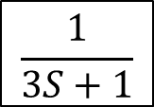
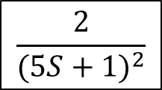
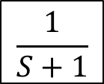
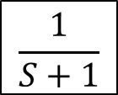
Example 4
Consider the closed system shown in the block diagram below.
a. Test the stability.
b. Is the system stable if Integral mode (I= 4 min) is added to the proportional controller(Kc=2.5)
$XL$(s)
$$\frac{1}{S+1}$$
+
+
$Ysp$(s)
$$\frac{1}{3S+1}$$
$$\frac{2}{(5S+1)^{2}}$$
+
$Yo$(s)
∑
$$2.5$$
∑
_
$$\frac{1}{S+1}$$

Slide 11
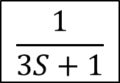
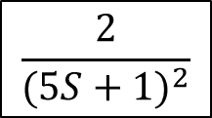
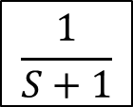
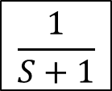
Solution
$XL$(s)
$$\frac{1}{S+1}$$
(a).
$$1+GG_{m}=0$$
+
+
$Ysp$(s)
$$\frac{1}{3S+1}$$
$$\frac{2}{(5S+1)^{2}}$$
+
$Yo$(s)
$$1+G_{v}G_{c}G_{p}G_{m}=0$$
∑
$$2.5$$
∑
_
$$1+\frac{\left(2.5)(2\right)}{\left.{\left(5S+1\right)}^{2}(3S+1)(S+1\right)}=0$$
$$\frac{1}{S+1}$$
$$\left(25S^{2}+10S+1\right)\left(3S^{2}+3S+S+1\right)+5=0$$
$$75 S^{4}+130S^{3}+68S^{2}+14S+6=0$$

Slide 12
$$75 S^{4}+130S^{3}+68S^{2}+14S+6=0$$
n
1
$$75$$
$$68$$
$$6$$
$$0$$
2
$$130$$
$$14$$
$$0$$
3
$$59.9$$
$$6$$
$$0$$
4
$$0.98$$
$$0$$
5
$$6$$
$$0$$
All the figures are positive
The system is stable

Slide 13
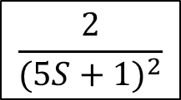
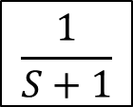
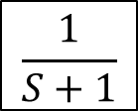
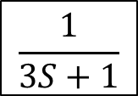
(b).
The controller is $G_{s}\left(s\right)=2.5(1+\frac{1}{4 S})=2.5\left(1+\frac{1}{4S}\right)=\frac{10S+2.5}{4S}$
$$\frac{1}{S+1}$$
$XL$(s)
$$1+GG_{m}=0$$
+
+
$Ysp$(s)
∑
$2.5(1+\frac{1}{4S}$)
$$\frac{1}{3S+1}$$
$$\frac{2}{(5S+1)^{2}}$$
+
$Yo$(s)
∑
_
$$\frac{1}{S+1}$$
$$1+\left(\frac{10S+2.5}{4S}\right)+\left(\frac{2}{{\left(5S+1\right)}^{2}\left(3S+1\right)\left(S+1\right)}\right)=0$$
$$1+\frac{20S+5}{\left.4S[(25S^{2}+10S+1)(3S^{2}+4S+1\right)}=0$$

Slide 14
$$300S^{5}+520 S^{4}+272S^{3}+56S^{2}+24S+5=0$$
n
1
$$300$$
$$272$$
$$24$$
$$0$$
2
$$520$$
$$56$$
$$5$$
$$0$$
3
$$239.7$$
$$21.1$$
$$0$$
4
$$10.22$$
$$5$$
5
$$−96.1$$
$$0$$
6
$$5$$
$$0$$
Negative figure
The system is unstable

Slide 15
Advantages of Routh Criterion
We can find the stability of the system without solving the characteristic equation.
2. By Routh method, we can determine the range of (Kc) or (I) or (R) for stability.

Slide 16
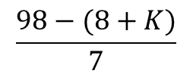
Example 5
Given the characteristic equation of a closed –loop system.
$S^{3}+7S^{2}+14S+8+K=0$
Find the range of K that makes the system stable .
Solution
$S^{3}+7S^{2}+14S+8+K=0$
n
1
$$1$$
$$14$$
$$0$$
2
7
$$8+K$$
$$0$$
3
$$\frac{98−(8+K)}{7}$$
$$0$$
4
$$8+K$$
$$0$$
Note : the value of K is always positive K > 0

Slide 17
$$\frac{\left.98−(8+K\right)}{7} >0$$
$$98−\left(8+K\right) >0$$
$$K <90$$
$$∴ The range of K is 0<K <90 which makes the system stable$$
$Note that the value K=90 make the value \frac{98−(8+K)}{7}=0$ so the system will be critically stable.
The value of K which make the system critically stable is called K_{max} or K _{critical} or limiting gain

Slide 18
Example 6
Given the characteristic equation of a closed –loop system.
${S^{4}+2S}^{3}+5S^{2}+8S+1+K=0$
Find the limiting gain K_{max}
2. Sketch the response when using K _{max} and find the frequency of the response (ω) and the time of one cycle Tc
Solution
${S^{4}+2S}^{3}+5S^{2}+8S+1+K=0$
1.
n
$$1$$
$$5$$
$$1+K$$
$$0$$
1
2
2
$$8$$
$$0$$
$$0$$
3
$$1$$
$$1+K$$
$$0$$
4
$$6−2K$$
$$0$$
5
$$1+K$$

Slide 19
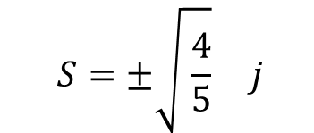
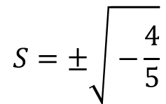
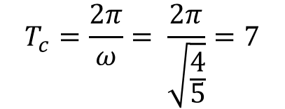
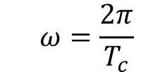
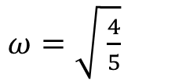
$$6−2K=0$$
$$K_{max}=3 limiting gain$$
3.
$$5 S^{2}+1+K=0$$
$$5 S^{2}+4=0$$
$$S^{2}=−\frac{4}{5}$$
y
$T_{c}$=7
$$S=±\sqrt{ −\frac{4}{5}}$$
$$S=±\sqrt{ \frac{4}{5}} j$$
y_{o}
$ω=\sqrt{ \frac{4}{5}}$
$$ω=\frac{2π}{T_{c}}$$
0
t
$$T_{c}=\frac{2π}{ω}= \frac{2π}{\sqrt{\frac{4}{5}}}=7$$

Slide 20
Home work 2
Repeat example 6 for characteristic equation :
${S^{4}+4S}^{3}+5S^{2}+4S+2+K=0$
Ans: K=2 , ω=0.894 Tc=7
Home work 3
Given the characteristic equation of a closed –loop system
${S^{4}+3S}^{3}+3S^{2}+2S+K=0$
Find the range of K that makes the system stable
$$Ans : The range of K is 0<K <\frac{14}{9} which makes the system stable$$

Slide 21
Example 7
Consider the closed-loop system whose transfer functions shown below. Find the range of Kc that makes the system stable and the limiting gain( Kc max)
$$G_{c}\left(s\right)=K_{c}\left(1+\frac{1}{s}\right) , G_{p}=\frac{0.25}{15S+1} , G_{v}=\frac{20}{3S+1} , G_{m}\left(s\right)=\frac{0.6}{S+1}$$
Solution:
$1+G\left(s\right)G_{m}\left(s\right)=$0
$$1+\frac{(0.25)(20)(0.6)K_{c}\left(\frac{s+1}{s}\right)}{(15S+1)(3S+1)(S+1)}=0$$
$$S\left(3S+1\right)\left(S+1\right)\left(15S+1\right)+3K_{c}\left(S+1\right)=0$$
$$S\left(45S^{3}+60S^{2}+15S+3S^{2}+4S+1\right)+3K_{c}S+3K_{c}=0$$
$$45S^{4}+63S^{3}+19S^{2}+\left(1+3K_{c}\right)S+3K_{c}=0$$

Slide 22
$$45S^{4}+63S^{3}+19S^{2}+\left(1+3K_{c}\right)S+3K_{c}=0$$
n
$$19$$
$$3K_{c}$$
$$0$$
1
$$45$$
2
63
$$1+3K_{c}$$
$$0$$
$$0$$
3
$$18.28−2.14 K_{c}$$
$$3K_{c}$$
$$0$$
4
$$\frac{−6.42K_{c}^{2}−136.3K_{c}+18.28}{18.28−2.14K_{c}}$$
$$0$$
5
$$3K_{c}$$
$$0$$
$$\frac{−6.42K_{c}^{2}−136.3K_{c}+18.28}{18.28−2.14K_{c}}>0$$

Slide 23
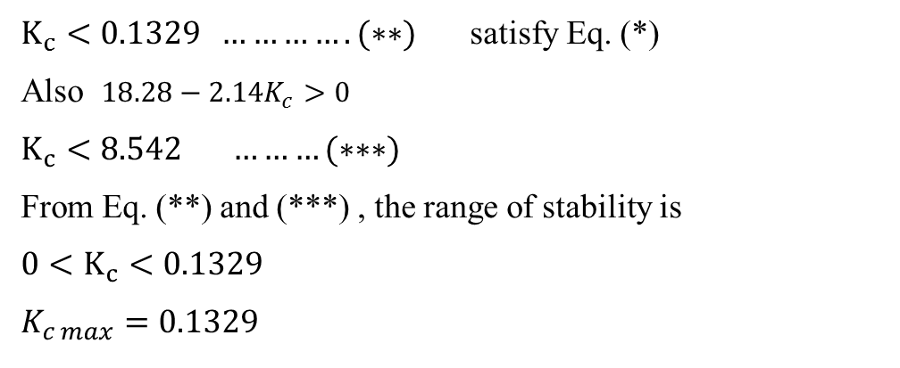
$$\frac{−6.42K_{c}^{2}−136.3K_{c}+18.28}{18.28−2.14K_{c}}>0$$
$$−6.42K_{c}^{2}−136.3K_{c}+18.28>0$$
$$\left.6.42K_{c}^{2}+136.3K_{c}−18.28<0 ………(∗\right)$$
$$K_{c}^{2}+21.23K_{c}−2.84<0$$
$$K_{c}=−21.36 يهمل$$
$$K_{c}=0.1329$$
$K_{c}<0.1329 ………….(∗∗)$ satisfy Eq. (*)
Also $18.28−2.14K_{c}>0$
$$K_{c}<8.542 ………(∗∗∗)$$
From Eq. (**) and (***) , the range of stability is
$$0<K_{c}<0.1329$$
$$K_{c max}=0.1329$$

Slide 24
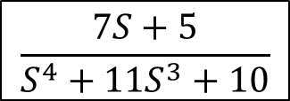
Example 8
Consider the closed system shown in the block diagram below. Find the range of the derivative time (R) which makes the system stable.
+
$Yo$(s)
Solution
∑
$$\frac{7S+5}{S^{4}+11S^{3}+10}$$
$Ysp$(s)
$$RS$$
_
$$1+GG_{m}=0$$
$$1+\left(RS\right)+\left(\frac{7S+5}{S^{4}+11S^{3}+10}\right)=0$$
$$S^{4}+11S^{3}+10 +7RS^{2}+5RS=0$$
$$S^{4}+11S^{3}+7RS^{2}+5RS+10=0$$

Slide 25
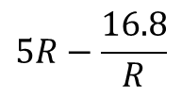
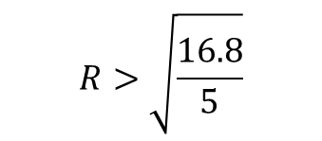
$$S^{4}+11S^{3}+7RS^{2}+5RS+10=0$$
n
$$1$$
$$7R$$
$$10$$
$$0$$
1
2
11
$$5R$$
$$0$$
$$0$$
3
$$6.545 R$$
$$10$$
$$0$$
4
$$5R−\frac{16.8}{R}$$
$$0$$
5
$$10$$
$$R>\sqrt{\frac{16.8}{5}}$$
$$5R−\frac{16.8}{R} >0$$
$$5R>\frac{16.8}{R}$$
$$R^{2}>\frac{16.8}{5}$$
$$R>1.833$$

Slide 26
Example 9
A closed-loop system consists of the following items
$$G_{c}\left(s\right)=K_{c} , G_{p}=\frac{0.25e^{−s}}{15S+1} , G_{v}=\frac{20}{3S+1} , G_{m}\left(s\right)=\frac{0.6}{S+1} , { G}_{L}(s)=\frac{3}{2S+1}$$
1- Sketch the block diagram.
2 – What is the range that make the system stable?
3– What is the limiting gain Kc max?
4- Determine the frequency of response (ω ) and cycle period Tc
5– Sketch the response.

Slide 27
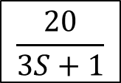
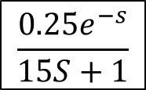
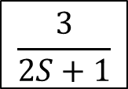
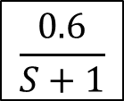
Solution
(1).
$XL$(s)
$$\frac{3}{2S+1}$$
+
+
+
$Ysp$(s)
$$\frac{20}{3S+1}$$
$$\frac{0.25e^{−s}}{15S+1}$$
$Yo$(s)
∑
$$Kc$$
∑
_
$$\frac{0.6}{S+1}$$

Slide 28
(1).
$1+GG_{m}=$0
$$1+\frac{\left(0.25)(20)(0.6) K_{c}e^{−s}\right.}{\left(15S+1)(3S+1)(S+1\right)}=0$$
$$1+\frac{3 K_{c}e^{−s}}{\left(15S+1)(3S+1)(S+1\right)}=0$$
$$45S^{3}+63S^{2}+19S+1+3K_{c} [\frac{1−0.5S}{1+0.5S}]=0$$
$$45S^{3}+63S^{2}+19S+1+3K_{c} [\frac{2−S}{2+S}]=0$$
$$\left(2+S\right)\left[45S^{3}+63S^{2}+19S+1\right]+3K_{c}(2−S)=0$$
$$45S^{4}+153S^{3}+145S^{2}+\left(39−3K_{c}\right)S+2+6K_{c}=0$$

Slide 29
(2).
Routh test
$$45S^{4}+153S^{3}+145S^{2}+\left(39−3K_{c}\right)S+2+6K_{c}=0$$
n
$$145$$
$$2+6Kc$$
$$0$$
1
$$45$$
2
153
$$39−3Kc$$
$$0$$
$$0$$
3
$$133.52+0.88K_{c}$$
$$2+6Kc$$
$$0$$
4
$$\frac{−2.64K_{c}^{2}−1284.24K_{c}+4901}{133.52+0.882K_{c}}$$
$$0$$
5
$$2+6Kc$$

Slide 30
$$\frac{−2.64K_{c}^{2}−1284.24K_{c}+4901}{133.52+0.882K_{c}} >0$$
$$−2.64K_{c}^{2}−1284.24K_{c}+4901>0$$
$$2.64K_{c}^{2}+1284.24K_{c}−4901<0$$
$$K_{c}^{2}+486.45 K_{c}−1856.43<0 (∗)$$
$$K_{c}^{2}+486.45 K_{c}−1856.43=0$$
$$K_{c}=−490.235 يهمل$$
$$K_{c}=3.78$$
$$K_{c} <3.78 satisfy Eq. (∗)$$
$${∴ The range for stability is 0<K}_{c} <3.78$$

Slide 31
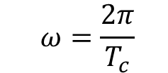
(3).
Limiting gain
$$\frac{−2.64K_{c}^{2}−1284.24K_{c}+4901}{133.52+0.882K_{c}} =0$$
$$K_{c}^{2}+486.45 K_{c}−1856.43=0$$
$$K_{c}=−490.235 يهمل$$
$$K_{c}=3.78 limiting gain$$
$$45S^{4}+153S^{3}+145S^{2}+\left(39−3K_{c}\right)S+2+6K_{c}=0$$
y
$T_{c}$=15.25
$$145S^{2}+2+6K_{c}=0$$
$$145S^{2}+24.68=0$$
y_{o}
$$S^{2}=−0.17$$
$$S_{1,2}=±\sqrt{−0.17 } = ±0.412 j$$
$$ω=0.412$$
0
t
$$ω=\frac{2π}{T_{c}}$$
$$T_{c}=\frac{2π}{ω}= \frac{2π}{0.412}=15.25$$

Slide 32
General notes
For characteristic equation
$$A_{n}S^{n}+A_{n−1}S^{n−1}+A_{n−2}S^{n−2}+…+A_{1}S+A_{o}=0$$
1- If the coefficients of the equation have different signs ( i.e. positive and negative) then no need to test , the system is unstable
${e.g S}^{3}−7S^{2}+14S+98=0$ is unstable
2- If there is a missing of any term, then no need to test , the system is not stable ( either critically stable or unstable)
${{e.g S}^{4}+9S}^{3}+30 S+18=0$ is unstable missing term of $S^{2}$
${S^{4}+9S}^{3}+29 S^{2}+30 S=0$ is critically stable missing the absolute term
3- If all the coefficients of the equation have the same sign and there are no missing terms , then the system should be tested to specify the stability.
${ 5S}^{3}+6 S^{2}+3S+2=0$ is stable
${ 9S}^{3}+6 S^{2}+3S+2=0$ is critically stable
${ 5S}^{3}+6 S^{2}+3S+15=0$ is unstable

Slide 33
Notes about sketching the response
y
$$\left(a\right). y=a−be^{−c t}$$
a
$$\left(b\right). y=a(1−be^{−c t})$$
0
t

Slide 34
y
$$\left(c\right). y=a−be^{−c t} sin (αt+β)$$
a
0
$\left(d\right). y=a[1−be^{−c t} sin (αt+β)$]
t
y
$$\left(e\right). y=be^{−c t} sin (αt+β)$$
0
t

Slide 35
y
$$\left(f\right). y=b{ e}^{c t} sin (αt+β)$$
0
t
y
$$\left(g\right). y=a+b{ e}^{c t} sin (αt+β)$$
a
0
t

Slide 36
y
$$\left(h\right). y=a+b sin (αt+β)$$
a
0
t
y
$$\left(i\right). y=b sin (αt+β)$$
0

Slide 37
Exercise
Sketch the following functions
$$y=5[1−2 e^{−2t}sin⁡(0.2t+1.17)]$$
$$y=10−2 e^{−2t}sin⁡(0.2t+1.17)$$
$$y=2 e^{2t}sin⁡(0.2t+1.17)$$
$$y=2 e^{−2t}sin⁡(0.2t+1.17)$$
$$y=2−3 e^{−2t}$$
$$y=2(1−3 e^{−2t})$$

Slide 38
Thank you for your attention
Any ?

